Slide 1

Bignum Calculator
by Joseph Pollack

Slide 2

library repo:
github.com/eindacor/JEPbignum
calculator repo:
github.com/eindacor/JEPbignum_calculator
library docs:
github.com/eindacor/JEPbignum/blob/master/README.md

Slide 3

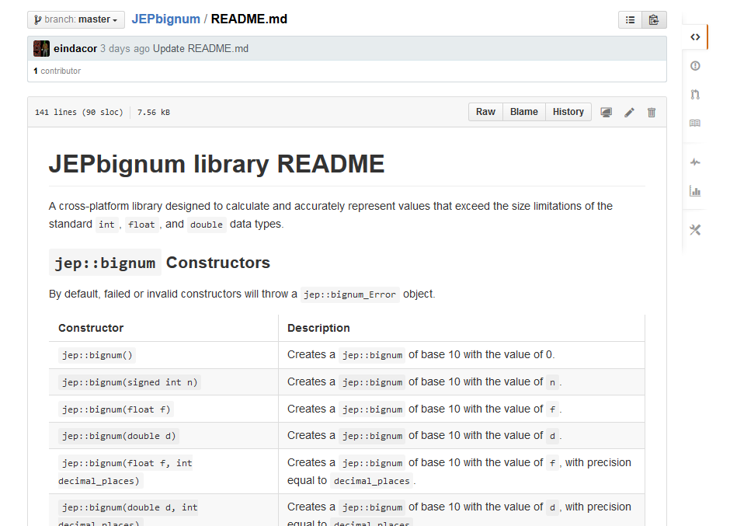

Slide 4

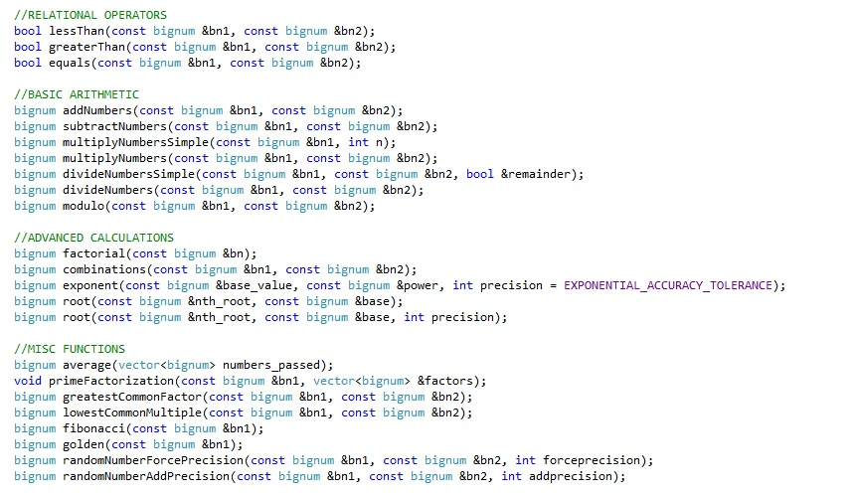

Slide 5

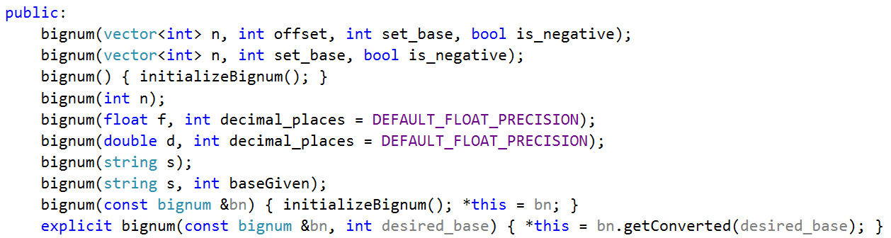

Slide 6
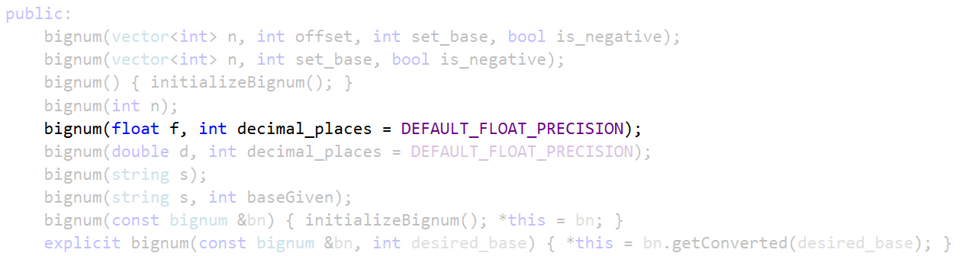

Slide 7

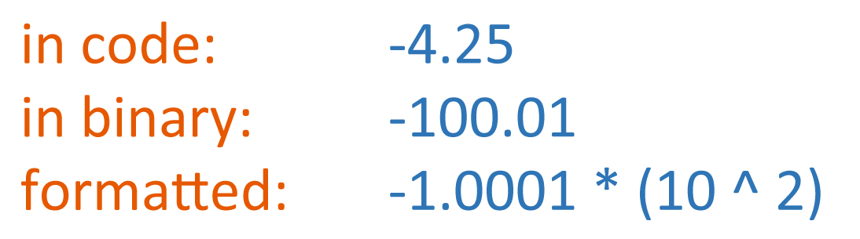

Slide 8
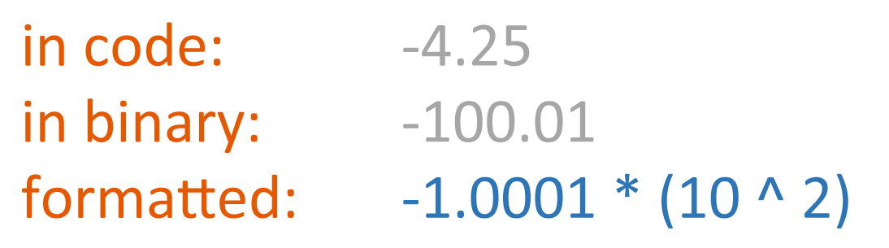

Slide 9
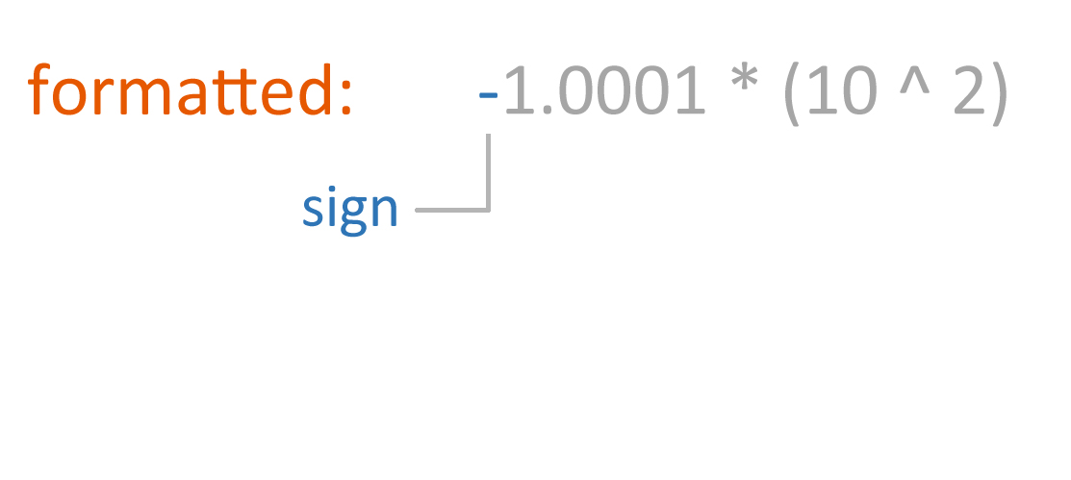

Slide 10
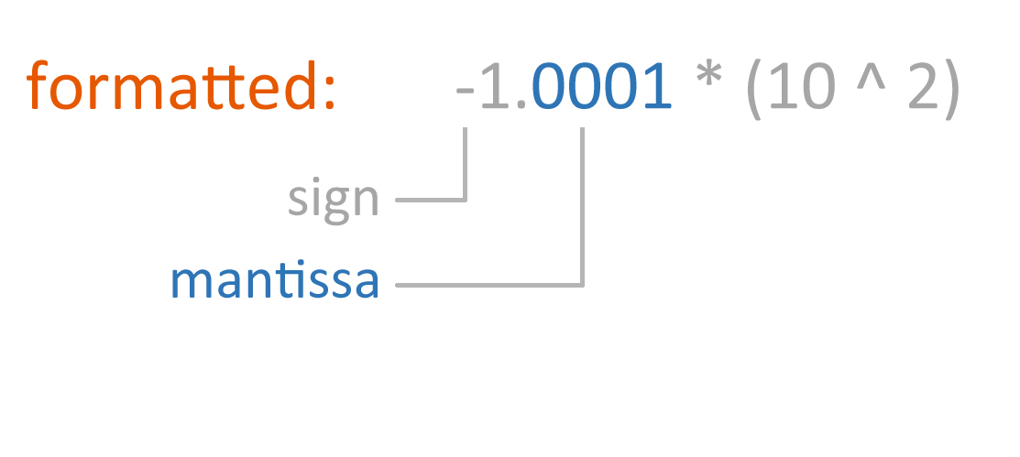

Slide 11
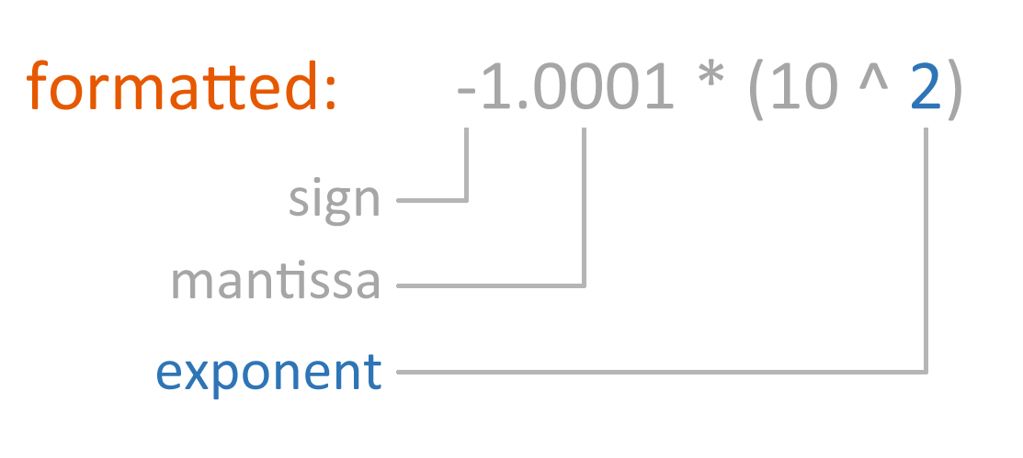

Slide 12
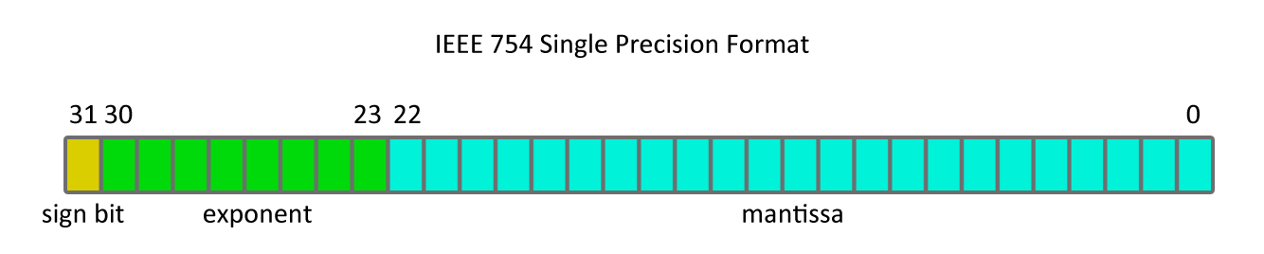
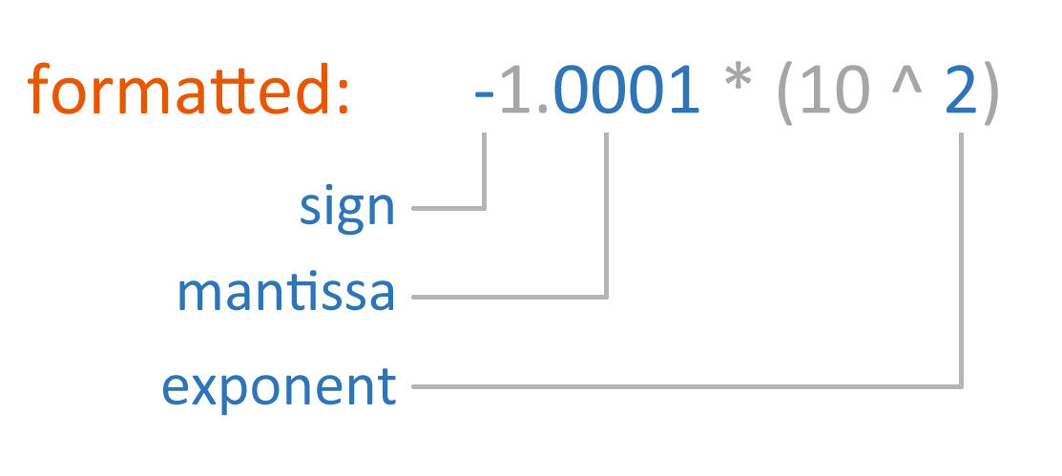

Slide 14

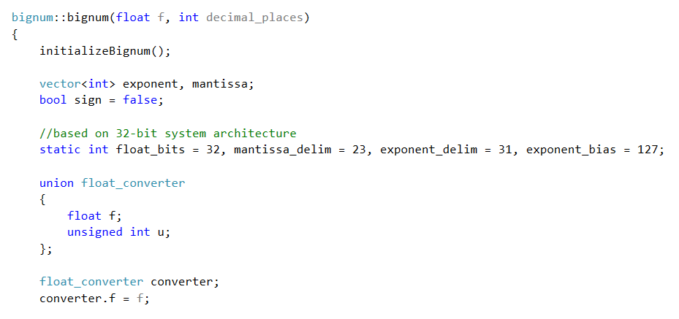

Slide 17
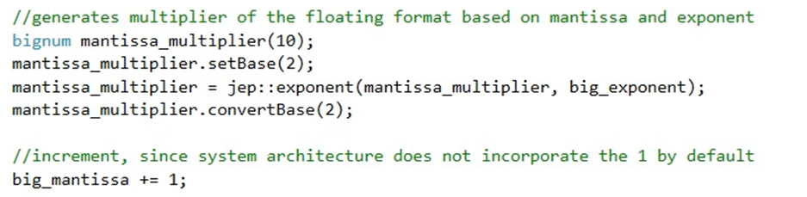

Slide 18
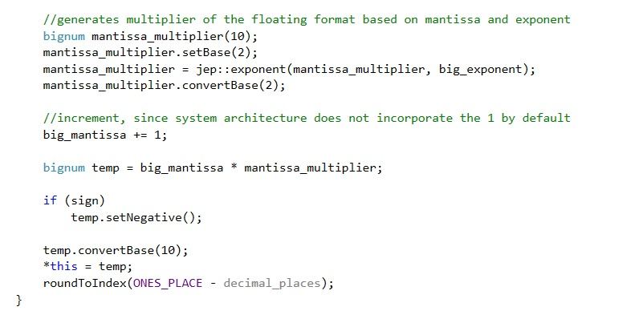

Slide 19
library repo:
github.com/eindacor/JEPbignum
calculator repo:
github.com/eindacor/JEPbignum_calculator
library docs:
github.com/eindacor/JEPbignum/blob/master/README.md

Slide 20
Bignum Calculator
by Joseph Pollack

Slide 21

Bignum Calculator

